Slide 1

Washington University, St. Louis
Data Analytics Bootcamp – Final Project
COVID-19 Risk Calculator
By: Michael Becker, Leo Huang, Aukje Rijpkema, Joseph Yi

Slide 2

Purpose of the Risk Calculator (cont.)
Use Machine Learning/Python to predict whether (based on age, gender, location and symptoms) someone is at:
Low risk (get well at home)
Medium risk (may need hospital care)
High risk (may need intensive care at not survive)
Use Machine Learning/Python to forecast:
# Cases / New Cases
# Hospitalizations / New Hospitalization
# Deaths / New Deaths

Slide 3
Purpose of the Risk Calculator
Use Tableau to interactively:
Plot % of population Infected/Deceased
Spread across the US over time
Use JS – FLASK – SQL server to interactively
Plot Cases/Hospitalizations by Country/State/County
Plot New Cases and Hospitalizations/Deaths per State

Slide 4
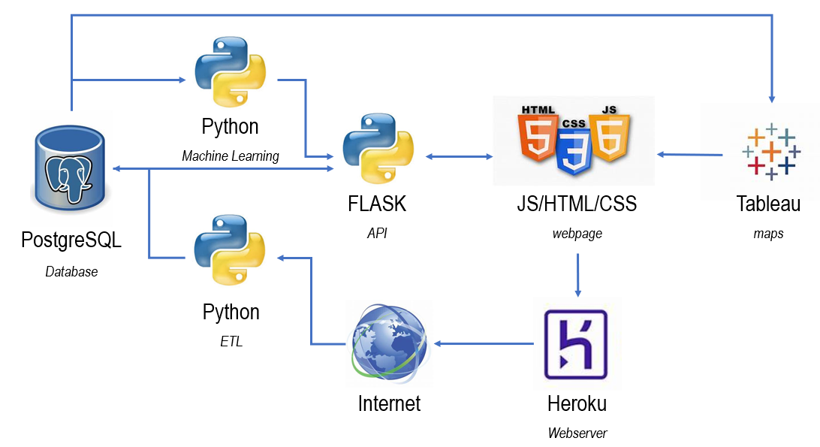
Architecture

Slide 5





Roles during this Project
M. Becker |  |  |  |  |  | X
L. Huang |  |  | X
A. Rijpkema | X | X |  | X | X |  | X
J. Yi |  |  |  |  | X
ETL
ML
FLASK

Slide 6
Interested in Details?

Slide 7
Architecture - Details
PostgreSQL Database 6 datasources – 10 views
Python ETL full + delta loads
Python ML 4 models
FLASK API 8 routes – 4 API endpoints
HTML/CSS/JS frontend web-application
Tableau integrated in web-application
Heroku application deployment

Slide 8
Application Functionality - Overview
Home Page – Race Chart by State
Risk Calculator Page – Find out how much you are at risk
Visualization Page – Geographic display of spread
Charts Page – Statistics by Country, State and County
About Page – Our Roles and Profiles
CDC-site – More information

Slide 9

Application Functionality: Web Design
Design and Content
Minimalist Design
Neutral color palette
Dynamic interactions with texts, alert boxes, and animated nav bar
Dynamic bar chart race
Text contents
Improvements

Slide 10
Application Functionality: Risk Calculator Page
Python ETL: Data from 2 early datasources:
~1000 closed cases (mostly hospitalizations + death)
~ 14000 open cases (tested positive but never reported back)
SQL: Data cleanup / reformatting to make consistent reporting possible
Python 4 Machine Learning models created and saved
Decision Tree
Deep Learning
Random Forest
K-Nearest Neighbor

Slide 11
Application Functionality: Risk Calculator Page cont.
JavaScript (HTML/CSS) input page allows for choice of:
Model
Age/Gender
Living/Travel Locations
Preconditions
Symptoms (12)
Result passed through FLASK API to retrieve predictions from chosen model
‘Model Evaluation’ chart - ML-model accuracy per gender/age subset

Slide 12
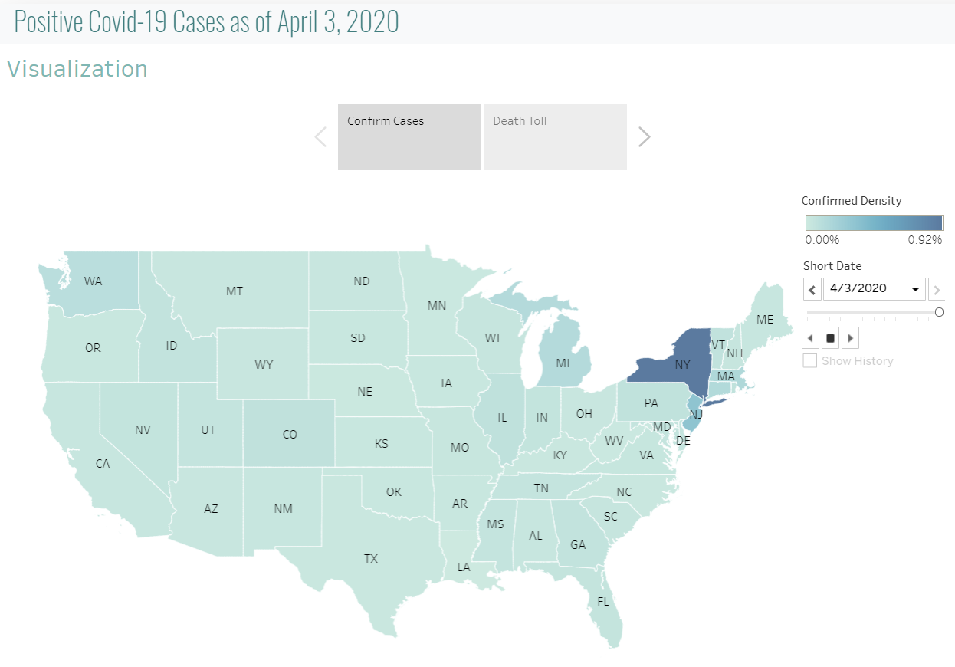
Application Functionality: Visualization Page

Slide 13
Application Functionality: Charts Page
5 Graphs with dropdown boxes for selection:
by Country – total positive, recovered, deceased
by State – total home and hospitalized, recovered, deceased
by State – daily positive case increase
by State – daily hospitalized and deceased increase
by County – total positive, recovered, deceased

Slide 14
Ambitions – What else we would like to do
Run ML models on more reliable, consistent data + larger dataset
Extend ML models with extra features (BMI, smokers, preconditions)
Add SVG of a Human to show percentages of symptoms

